Slide 2
This is God’s Word for my life in this Place and at this Time. Today I am a new creation in Christ, I am God’s very own, and I KNOW He has a purpose for my life.

Slide 3
Be merciful, just as your Father is merciful.
“Do not judge, and you will not be judged. Do not condemn, and you will not be condemned. Forgive, and you will be forgiven. Give, and it will be given to you. A good measure, pressed down, shaken together and running over, will be poured into your lap.

Slide 4
For with the measure you use, it will be measured to you.”
He also told them this parable: “Can the blind lead the blind? Will they not both fall into a pit? The student is not above the teacher, but everyone who is fully trained will be like their teacher.

Slide 5
“Why do you look at the speck of sawdust in your brother’s eye and pay no attention to the plank in your own eye? How can you say to your brother, ‘Brother, let me take the speck out of your eye,’ when you yourself fail to see the plank in your own eye?

Slide 6
You hypocrite, first take the plank out of your eye, and then you will see clearly to remove the speck from your brother’s eye.
Like 6:36-42

Slide 7
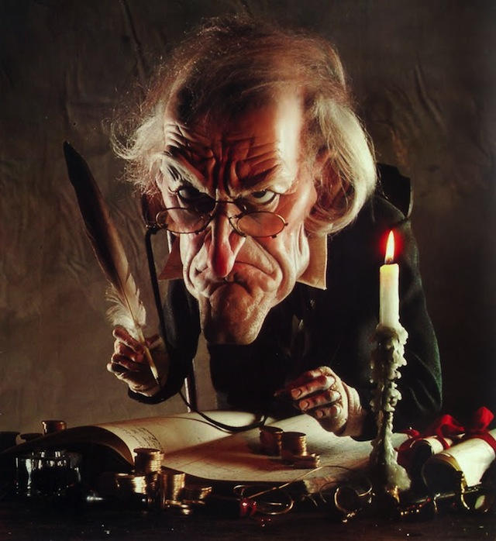

Slide 8
There is a little bit of
Scrooge in all of us.

Slide 9
GENEROSITY is the best cure for a Heart-cold

Slide 10
It must flow OUTWARDLY
“I will bless you and you will be a blessing to others.” Gen 12
When we bless others, we feel God’s presence flow

Slide 11
It must flow FAITHFULLY
Give us today our daily bread. Matthew 6:11
When we bless others, we trust God with our present

Slide 12
It must flow CONFIDENTLY
Give your life away and you’ll find your life given back. But not merely given back, but with bonus and blessing. Lk 6:38
When we bless others, we trust God with our future

Slide 13
It must flow CONSISTENTLY
“Much is required from those to whom much is given. For their responsibility is greater.” Luke 12

Slide 14
It must flow CONSISTENTLY
To one he gave five bags of gold, to another two bags, and to another one bag, each according to his ability. Matt 25:15
When we bless others, we are being transformed.

