Slide 1
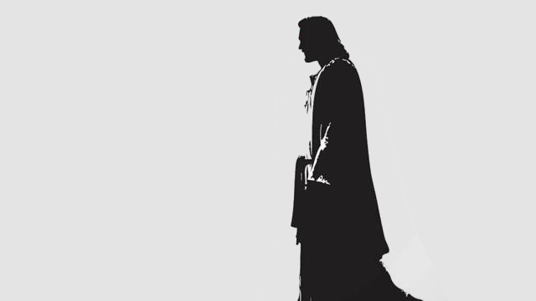
Who is
www.stevegedon.com

Slide 2
This is God’s Word for my life in this Place and at this Time. Today I am a new creation in Christ, I am God’s very own, and I KNOW He has a purpose for my life.

Slide 3
Therefore everyone who hears these words of mine and puts them into practice is like a wise man who built his house on the rock. The rain came down, the streams rose, and the winds blew and beat against that house; yet it did not fall, because it had its foundation on the rock.

Slide 4
But everyone who hears these words of mine and does not put them into practice is like a foolish man who built his house on sand. The rain came down, the streams rose, and the winds blew and beat against that house, and it fell with a great crash.”

Slide 5
When Jesus had finished saying these things, the crowds were amazed at his teaching, because he taught as one who had authority, and not as their teachers of the law.
Matthew 13:24-29

Slide 6
The people were all so amazed that they asked each other, “What is this? A new teaching—and with authority!” Mark 1:27

Slide 7
When the Sabbath came, he began to teach in the synagogue, and many who heard him were amazed. “Where did this man get these things?” they asked. “What’s this wisdom that has been given him? What are these remarkable miracles he is performing?
Mark 6:2

Slide 8
Ego says:
Once everything falls into place, I will find peace.
Jesus says:
Find peace, and everything will fall into place.

Slide 9
Jesus INSPIRED and IRRITATED his students
“The chief priests and the teachers of the law heard this and began looking for a way to kill him, for they feared him, because the whole crowd was amazed at his teaching.” Mark 11:18

Slide 10
“If you believe what you like in the Gospel and reject what you don’t like, it is not the Gospel you believe, but yourself.” St. Augustine

Slide 11
Jesus taught with GRACE and TRUTH
Grace without truth is HYPOCRISY
Truth without grace is BRUTALITY

Slide 12
When they kept on questioning him, he straightened up and said to them, “Let any one of you who is without sin be the first to throw a stone at her.” John 8:7
“When there is something to blame, there is no growth.”

Slide 13
Jesus was painfully PRACTICAL and PERSONAL
“Then he said to them, “So give back to Caesar what is Caesar’s, and to God what is God’s.” When they heard this, they were amazed. So they left him and went away. Matt. 22:21

Slide 14
If someone slaps you on one cheek, turn to them the other also. If someone takes your coat, do not withhold your shirt from them.
Give to everyone who asks you, and if anyone takes what belongs to you, do not demand it back.
Luke 6:30

Slide 15
Jesus asked them, “Don’t you have any faith?”
But they were frightened and amazed. They said to each other, “Who is this?”
Luke 8:25

