Slide 1
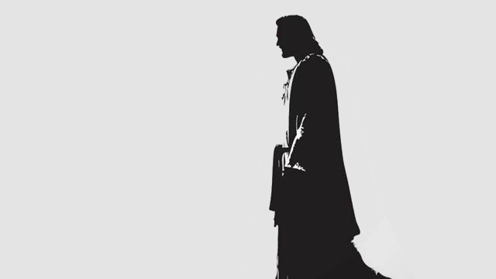
Who is this Man?
www.stevegedon.com

Slide 2
This is God’s Word for my life in this Place and at this Time. Today I am a new creation in Christ, I am God’s very own, and I KNOW He has a purpose for my life.

Slide 3
When Jesus had finished these parables, he moved on from there. Coming to his hometown, he began teaching the people in their synagogue, and they were amazed. “Where did this man get this wisdom and these miraculous powers?” they asked.

Slide 4
“Isn’t this the carpenter’s son? Isn’t his mother’s name Mary, and aren’t his brothers James, Joseph, Simon and Judas? Aren’t all his sisters with us? Where then did this man get all these things?”

Slide 5
And they took offense at him.
But Jesus said to them, “A prophet is not without honor except in his own town and in his own home.” And he did not do many miracles there because of their lack of faith.
Matthew 13:53-58

Slide 6
No one knows the pressure,
the disappointment and frustration
I’m going through.

Slide 7
Jesus walked in our SHOES
“He made himself nothing by taking the very nature of a servant, being made in human likeness.” Phil 2:7

Slide 8
Jesus was frustrated by CRAZY PEOPLE
“How much more valuable is a person than a sheep! Therefore it is lawful to do good on the Sabbath.” Matt 12:12
Jesus asked them, “Which is lawful on the Sabbath: to do good or to do evil, to save life or to kill?” But they remained silent. Mark 3:4

Slide 9
God of the Universe (infinite in wisdom, power and love)
Knows my pain and problems (from experience)
Offers the only perfect solution (Jesus)

Slide 10
“Come to me, all you who are weary and burdened, and I will give you rest. Take my yoke upon you and learn from me, for I am gentle and humble in heart, and you will find rest for your souls.”
Matthew 11:28-29

Slide 11
That should make you feel like saying,
“The Lord helps me! Why should I be afraid of what people can do to me?”
Hebrews 13:6

