Slide 1
What difference does it make?

Slide 2
This is God’s Word for my life in this Place and at this Time. Today I am a new creation in Christ, I am God’s very own, and I KNOW He has a purpose for my life.
Pentecost

Slide 3
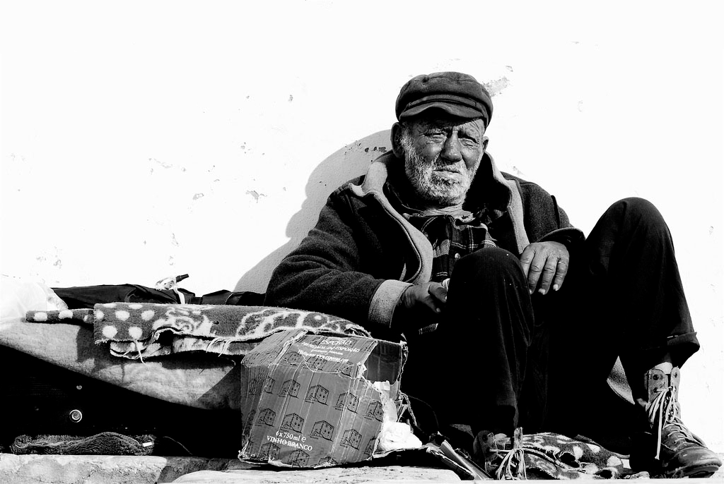
“There was a rich man who was dressed in purple and fine linen and lived in luxury every day. At his gate was laid a beggar named Lazarus, covered with sores and longing to eat what fell from the rich man’s table. Even the dogs came and licked his sores.

Slide 4
“The time came when the beggar died and the angels carried him to Abraham’s side. The rich man also died and was buried. In Hades, where he was in torment, he looked up and saw Abraham far away, with Lazarus by his side.

Slide 5
So he called to him, ‘Father Abraham, have pity on me and send Lazarus to dip the tip of his finger in water and cool my tongue, because I am in agony in this fire.’ “But Abraham replied, ‘Son, remember that in your lifetime you received your good things, while Lazarus received bad things, but now he is comforted here and you are in agony.

Slide 6
And besides all this, between us and you a great chasm has been set in place, so that those who want to go from here to you cannot, nor can anyone cross over from there to us.’

Slide 7
“He answered, ‘Then I beg you, father, send Lazarus to my family, for I have five brothers. Let him warn them, so that they will not also come to this place of torment.’
“Abraham replied, ‘They have Moses and the Prophets; let them listen to them.’

Slide 8
“‘No, father Abraham,’ he said, ‘but if someone from the dead goes to them, they will repent.’
“He said to him, ‘If they do not listen to Moses and the Prophets, they will not be convinced even if someone rises from the dead.’”
Luke 16:19-31

Slide 9
Gospel Response

Slide 10
Who is sitting at my GATE?
Who is within my sphere of influence?
Who lives at the edge but has become almost invisible?
Who is struggling, suffering or lonely?

Slide 11
What is my normal RESPONSE?
We create our own CHASM

Slide 12
“For this people’s heart has become calloused; they hardly hear with their ears, and they have closed their eyes. Otherwise they might see with their eyes, hear with their ears, understand with their hearts and turn, and I would heal them.” Matthew 13:15

Slide 13
God’s Word confronts Human APATHY
“The worst sin towards our fellow creatures is not to hate them, but to be indifferent to them; that's the essence of inhumanity." G.B. Shaw

Slide 14
Then the Lord asked Cain, “Where is Abel?”
“How should I know?” he answered. “Am I supposed to look after my brother?” Genesis 4:9

Slide 15
“Do not mistreat or oppress a foreigner, for you were foreigners in Egypt. “Do not take advantage of the widow or the fatherless. If you do and they cry out to me, I will certainly hear their cry. My anger will be aroused, and I will kill you with the sword; your wives will become widows and your children fatherless.” Exodus 22:21-24

Slide 16
Is this the kind of fast I have chosen, only a day for people to humble themselves? Is it only for bowing one’s head like a reed and for lying in sackcloth and ashes? Is that what you call a fast, a day acceptable to the Lord?

Slide 17
“Is not this the kind of fasting I have chosen: to loose the chains of injustice and untie the cords of the yoke, to set the oppressed free and break every yoke? Is it not to share your food with the hungry and to provide the poor wanderer with shelter— when you see the naked, to clothe them, and not to turn away from your own flesh and blood?”
Isaiah 58:5-7

Slide 18
Am I RESPONSIBLE? (Matthew 25:40, Ephesians 2:8-10)
Am I ALERT? (Ephesians 5:14-15)
Am I ACTIVE? (James 2)

