Slide 1
I AM
Discovering the Character of God

Slide 2
Jeremiah 18

Slide 3
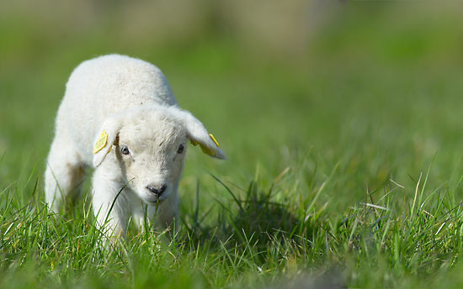
This is God’s Word for my life in this Place and at this Time. Today I am a new creation in Christ, I am God’s very own, and I KNOW He has a purpose for my life.

Slide 4
The Lord is my shepherd; I shall not want. He maketh me to lie down in green pastures: he leadeth me beside the still waters.

Slide 5
He restoreth my soul: he leadeth me in the paths of righteousness for his name's sake. Yea, though I walk through the valley of the shadow of death, I will fear no evil: for thou art with me; thy rod and thy staff they comfort me.

Slide 6
Thou preparest a table before me in the presence of mine enemies: thou anointest my head with oil; my cup runneth over.
Surely goodness and mercy shall follow me all the days of my life: and I will dwell in the house of the Lord for ever. Psalm 23

Slide 7
“The Lord is My Shepherd,
I have all that I need”

Slide 8
A Choice
an act of FAITH and REASON

Slide 9
A Celebration
“fear will not rule my life”

Slide 10
A Covenant
imprinted on our heart

Slide 11
Will You Come to The Table?
A Table of Letting Go.
At Table of Welcome.
A Table of Feasting.

Slide 12
“In some strange way I am still alive. I wonder what God means me to do with a life so specially spared?”

Slide 13
“I AM the Good Shepherd. The Good Shepherd lays down his life for his sheep.”
John 10:11

