Slide 1
Epiphany
to comprehend the essence or meaning of something,
Experience an "Aha!" moment

Slide 2
“Do not store up for yourselves treasures on earth, where moth and rust destroy, and where thieves break in and steal. But store up for yourselves treasures in heaven, where moth and rust do not destroy, and where thieves do not break in and steal. For where your treasure is, there your heart will be also.

Slide 3
“The eye is the lamp of the body. If your eyes are good, your whole body will be full of light. But if your eyes are bad, your whole body will be full of darkness. If then the light within you is darkness, how great is that darkness!

Slide 4
“No one can serve two masters. Either he will hate the one and love the other, or he will be devoted to the one and despise the other. You cannot serve both God and Money. Matthew 6:19-24

Slide 5
Epiphany
Barriers
Costs
Fear
Risks
Uncertainty

Slide 6
Experience your ‘aha’ moment
“Aha” moment that reveals our true Nature

Slide 7
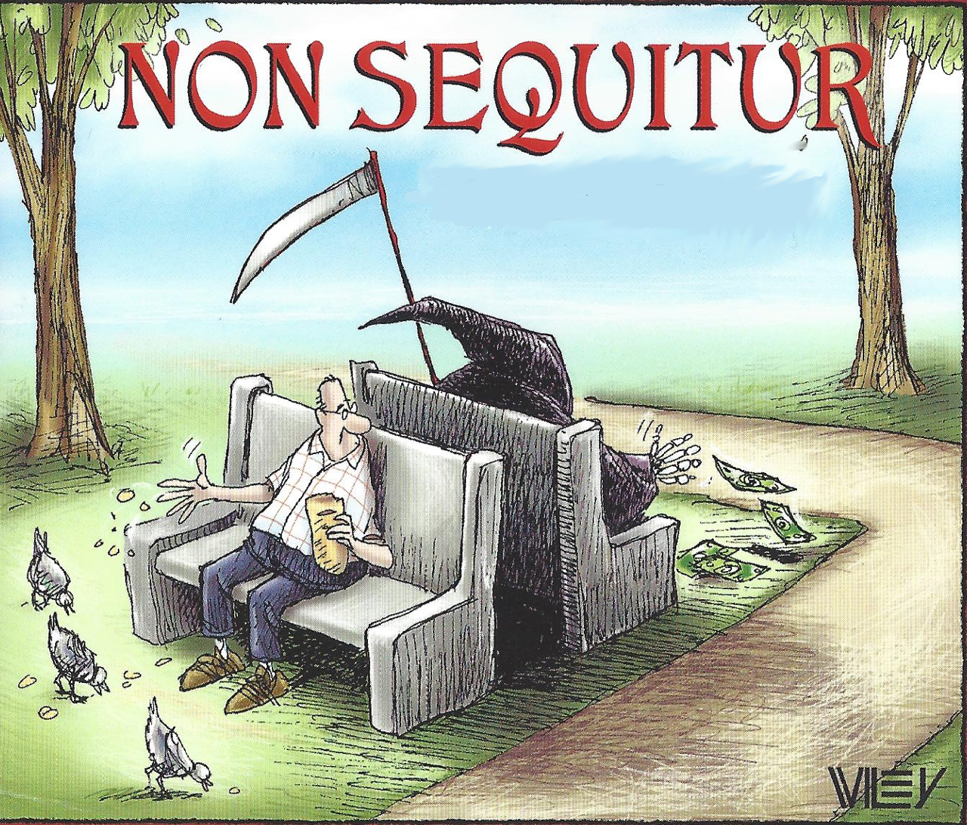

Slide 8
Seek something more VALUABLE
“What is more, I consider everything a loss compared to the surpassing greatness of knowing Christ Jesus my Lord, for whose sake I have lost all things. I consider them rubbish, that I may gain Christ.” Phil 3:8
Experience your ‘aha’ moment

Slide 9
Learn what to KEEP and what to RELEASE
“Do not store up for yourselves treasures on earth, where moth and rust destroy, and where thieves break in and steal.” Mt 6:19
Experience your ‘aha’ moment

Slide 10
Giving becomes
PURPOSEFUL, EXPECTANT & GENEROUS
Experience your ‘aha’ moment

Slide 11
P I give to… (help others, share the Gospel, etc.)
E I give to change… (the world, me, attitudes, etc.)
G I give because God… (loves me, provides, cares)
Experience your ‘aha’ moment

